Slide 1


Monitoring Meeting
2022

Slide 2

Activities implemented since 30.06.2022.
Television programs on TV24
Poster + calendar for Teachers' Day with the motto of social dialogue
Two handbooks on social dialogue
Six presentations on social dialogue
Banner
6. The regulations of the social dialogue award have been developed, a competition has been organized
7. A conference «Support of young pedagogues within the framework of social dialogue» was organized and social dialogue awards were presented
8. Information reflected in LIZDA's www and social accounts
9. point of the government's declaration on the establishment of the industry council

Slide 3


Declaration on the leadership of Arturas Krišjānis Kariņas
The activities planned by the Cabinet of Ministers
We commit to implementing new reforms or improving the ones already started, in all in education levels to provide adequate resources for their quality and timely for implementation, as well as to involve the social and cooperation partners of the industry by creating industry councils.
https://www.mk.gov.lv/lv/media/14490/download?attachment
on page 13

Slide 4
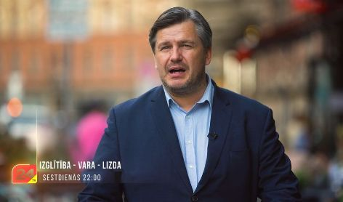
https://xtv.lv/rigatv24/video/mO7rQkaKNMK-03_09_2022_izglitiba_vara_lizda_1_dala
https://xtv.lv/rigatv24/video/lmNmRBq57OP-03_09_2022_izglitiba_vara_lizda_2_dala
27.08.2022.
https://xtv.lv/rigatv24/video/wY7PQzQ5G9E-27_08_2022_izglitiba_vara_lizda_1_dala
https://xtv.lv/rigatv24/video/6gGgZaZ67b4-27_08_2022_izglitiba_vara_lizda_2_dala
03.09.2022.
https://xtv.lv/rigatv24/video/mO7rQkaKNMK-03_09_2022_izglitiba_vara_lizda_1_dala
https://xtv.lv/rigatv24/video/lmNmRBq57OP-03_09_2022_izglitiba_vara_lizda_2_dala
TV programs on social dialogue with representatives of the Ministry of Education and Science, the Association of Heads of Educational Institutions of Latvia, the Association of Large Cities of Latvia, the Union of Latvian Municipalities, the Council of Young Education Workers, the 13th Saeima, educational boards, and municipalities.

Slide 5
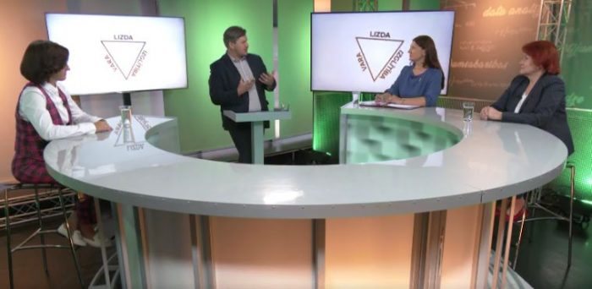
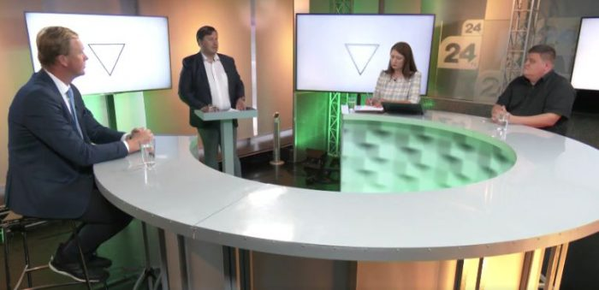
10.09.2022.
https://xtv.lv/rigatv24/video/x2NAbmxP7rd-10_09_2022_izglitiba_vara_lizda_1_dala
https://xtv.lv/rigatv24/video/Vnplk0EjGz2-10_09_2022_izglitiba_vara_lizda_2_dala
17.09.2022.
https://xtv.lv/rigatv24/video/mz7B0n2vpXE-17_09_2022_izglitiba_vara_lizda_1_dala
https://xtv.lv/rigatv24/video/20Gyorv5NvE-17_09_2022_izglitiba_vara_lizda_2_dala
24.09.2022.
https://xtv.lv/rigatv24/video/8AGOYOKPNQ2-24_09_2022_izglitiba_vara_lizda_1_dala
https://xtv.lv/rigatv24/video/wY7PQzr5G9E-24_09_2022_izglitiba_vara_lizda_2_dala

Slide 6

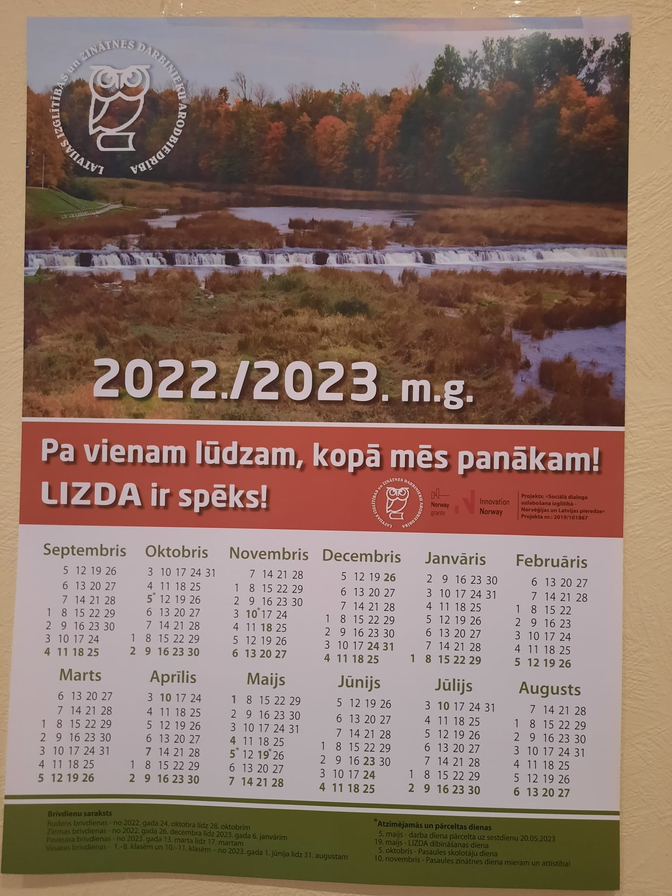
Poster + calendar for Teachers' Day with the motto of social dialogue

Slide 7
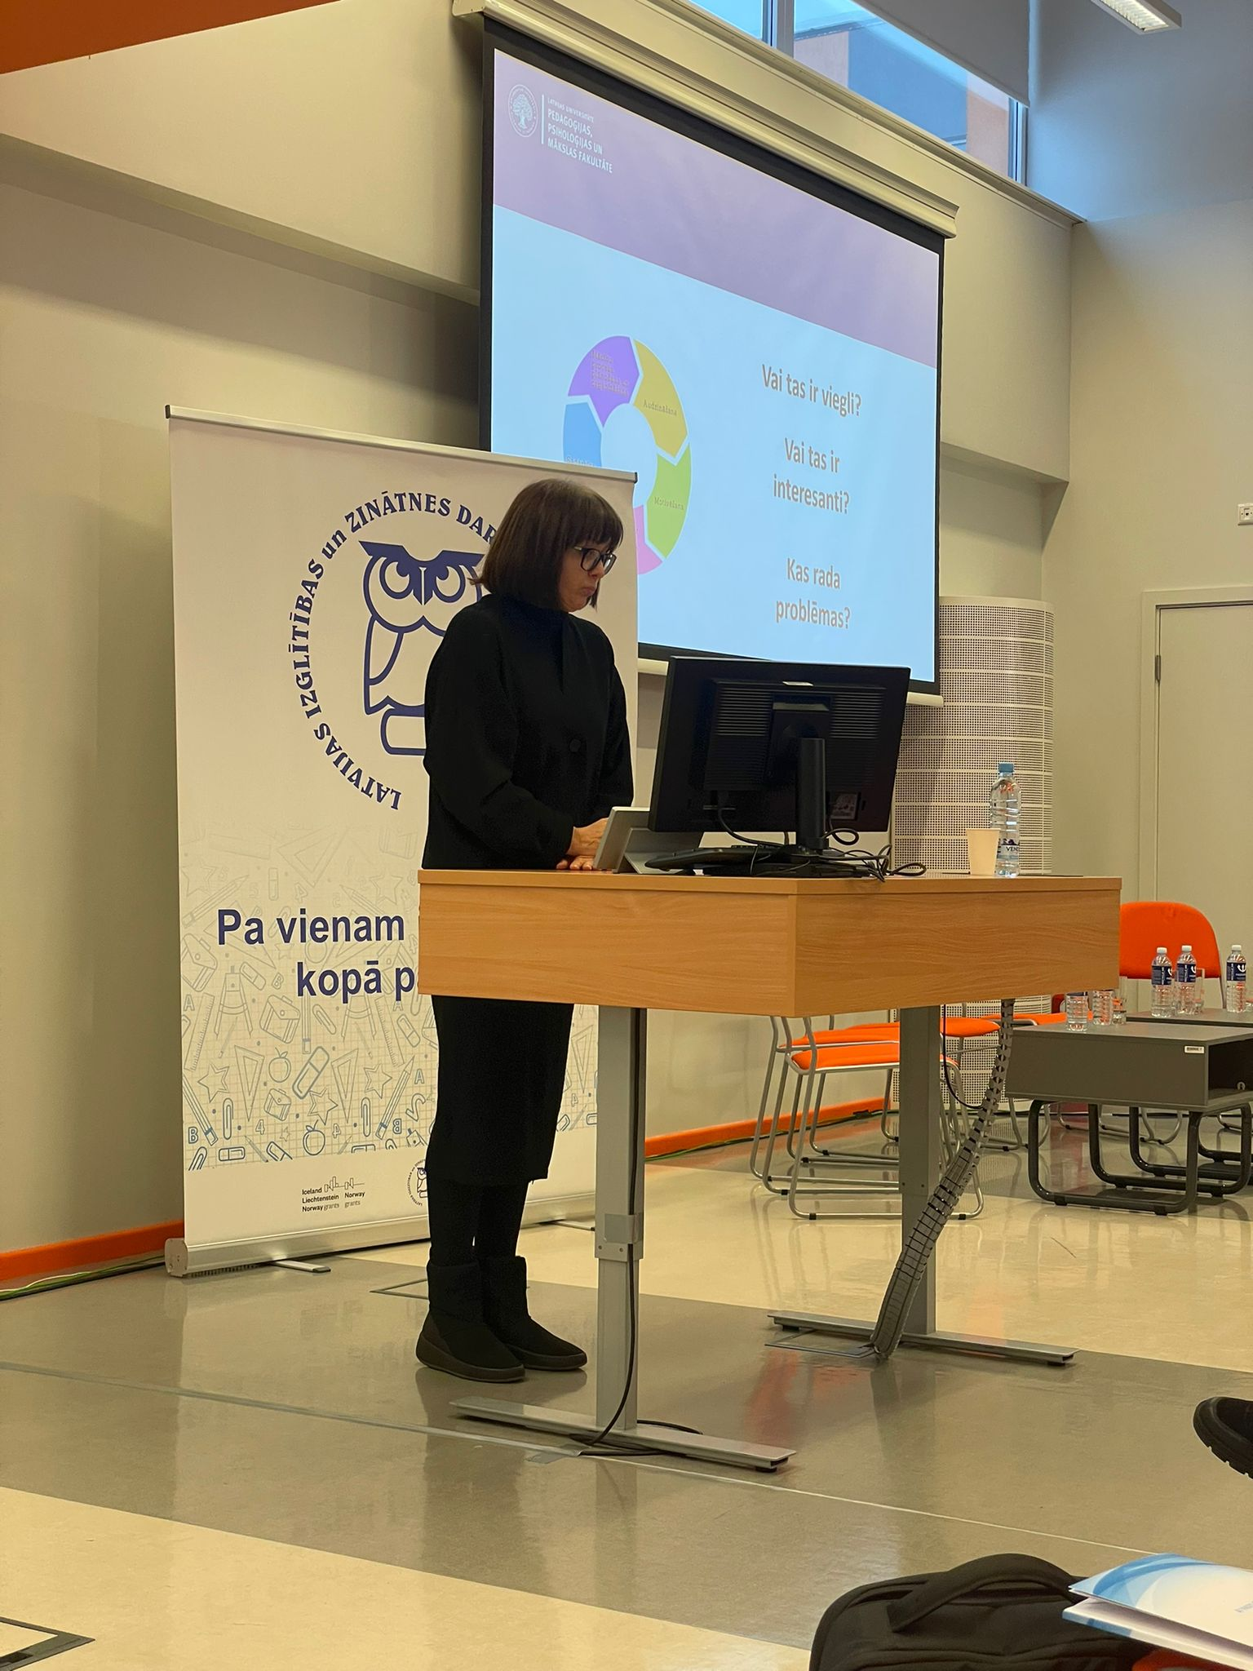

Banner

Slide 8
Six presentations on social dialogue. Included topics:
Social dialogue
Social and cooperation partners
Bilateral and tripartite social dialogue
Social and cooperation partners in the education sector
Latvian Employers Confederation
Free Trade Union Confederation of Latvia
Cabinet of Ministers
Social dialogue in Latvia and Europe
9. Normative acts regulating social dialogue
10. Social dialogue and civic participation
11. Areas of social dialogue partnership
12. Ethics of the implementation of social dialogue
13. Collective agreement
14. General agreement
15. The role of media in social dialogue

Slide 9
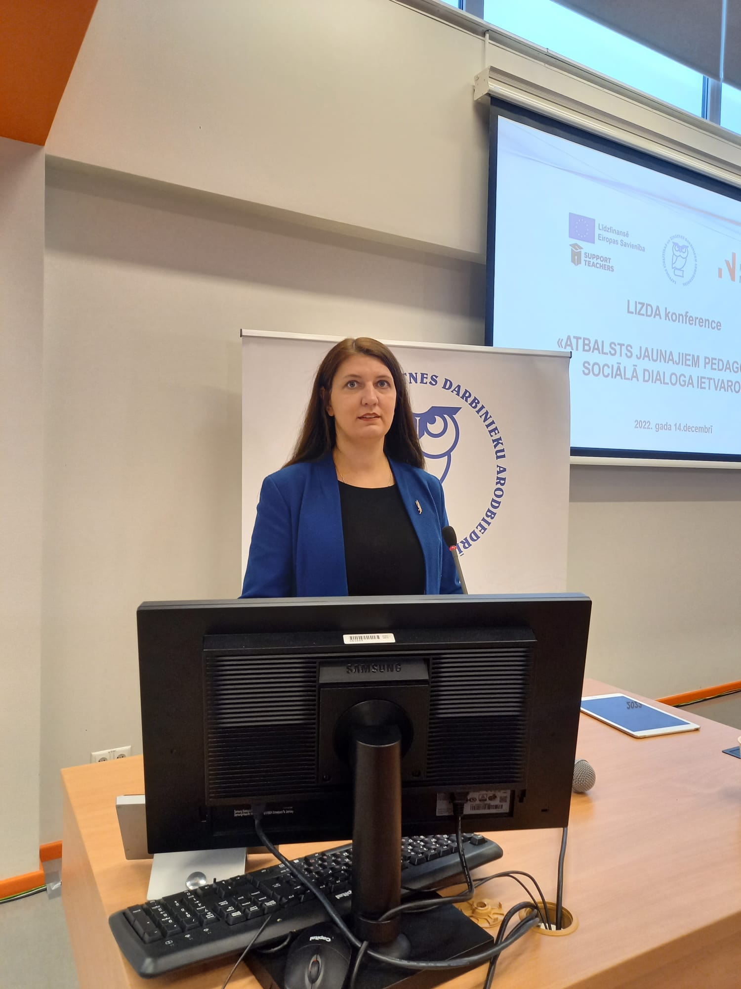
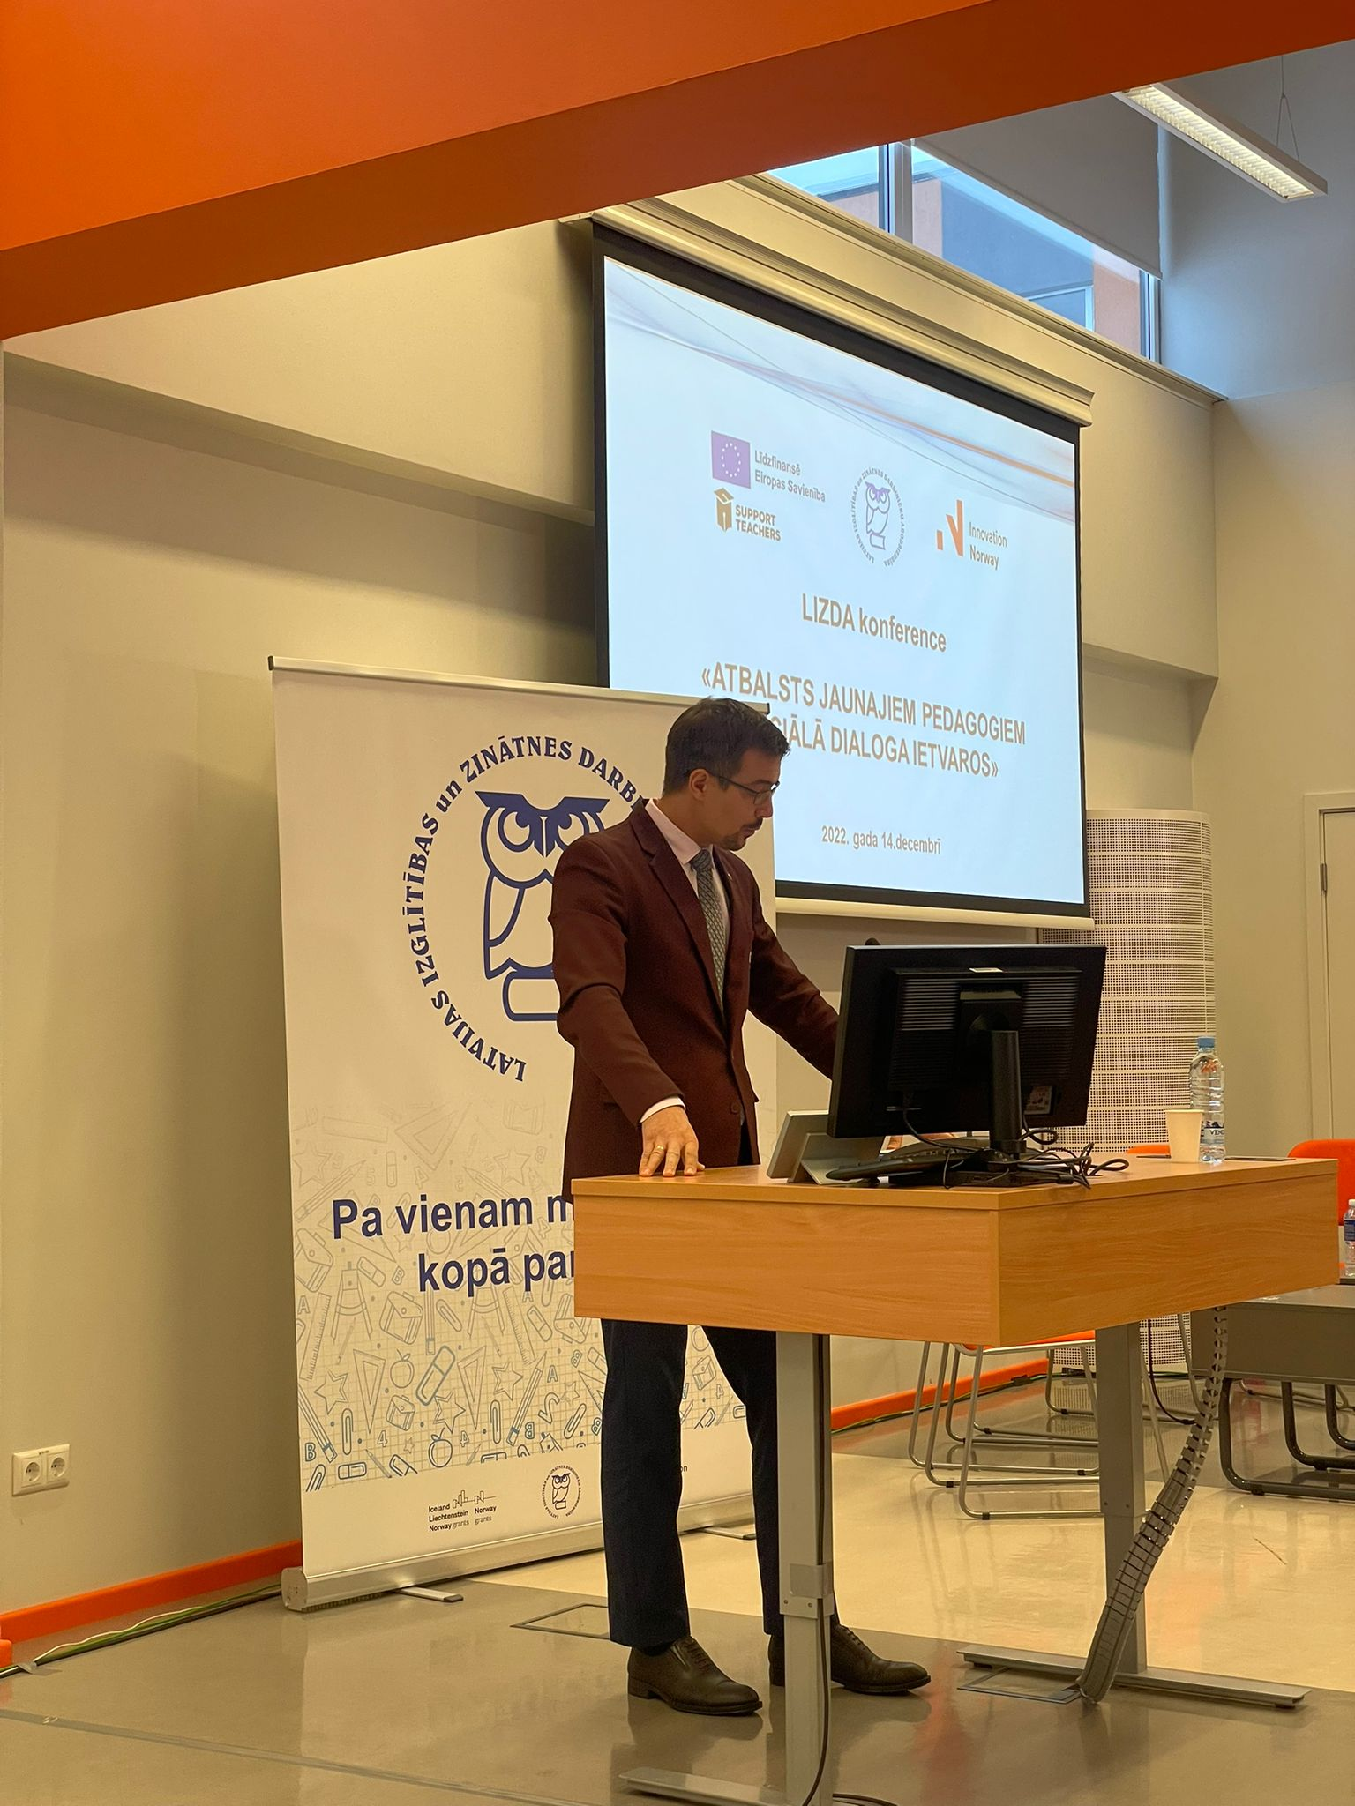
A conference «Support of young pedagogues within the framework of social dialogue», 14.12.2022.
The reports were presented by representatives of the Ministry of Education and Science, the Association of Managers of Latvian Educational Institutions, municipalities, universities and LIZDA.

Slide 10
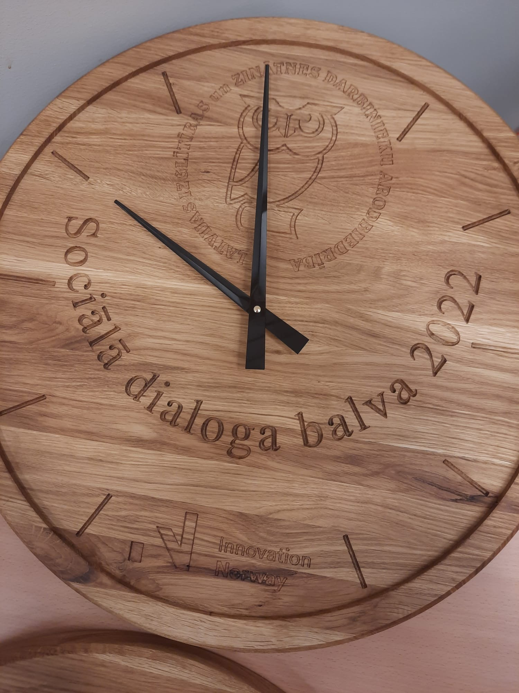
Social Dialogue Awards 2022,
14.12.2022.

Slide 11
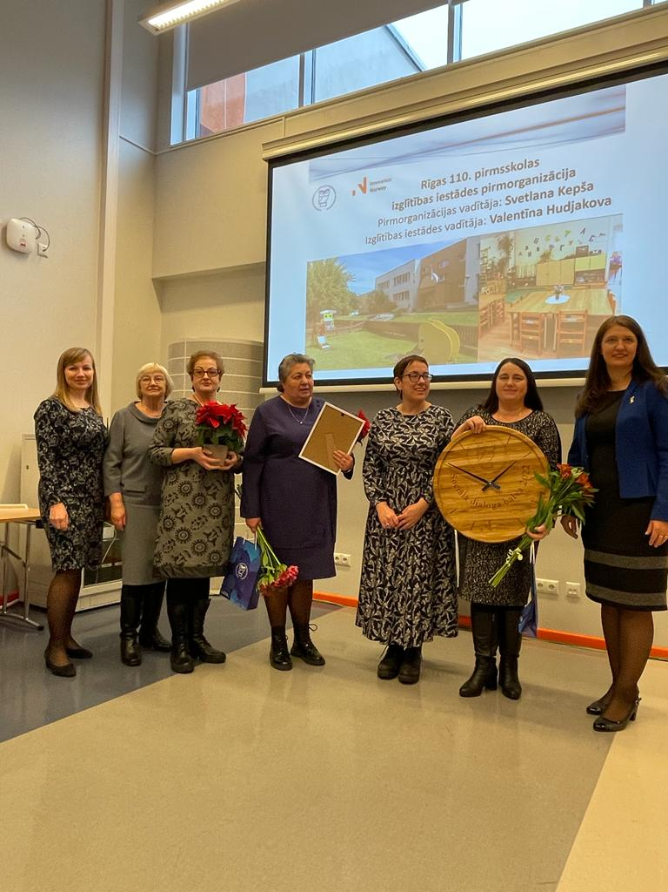
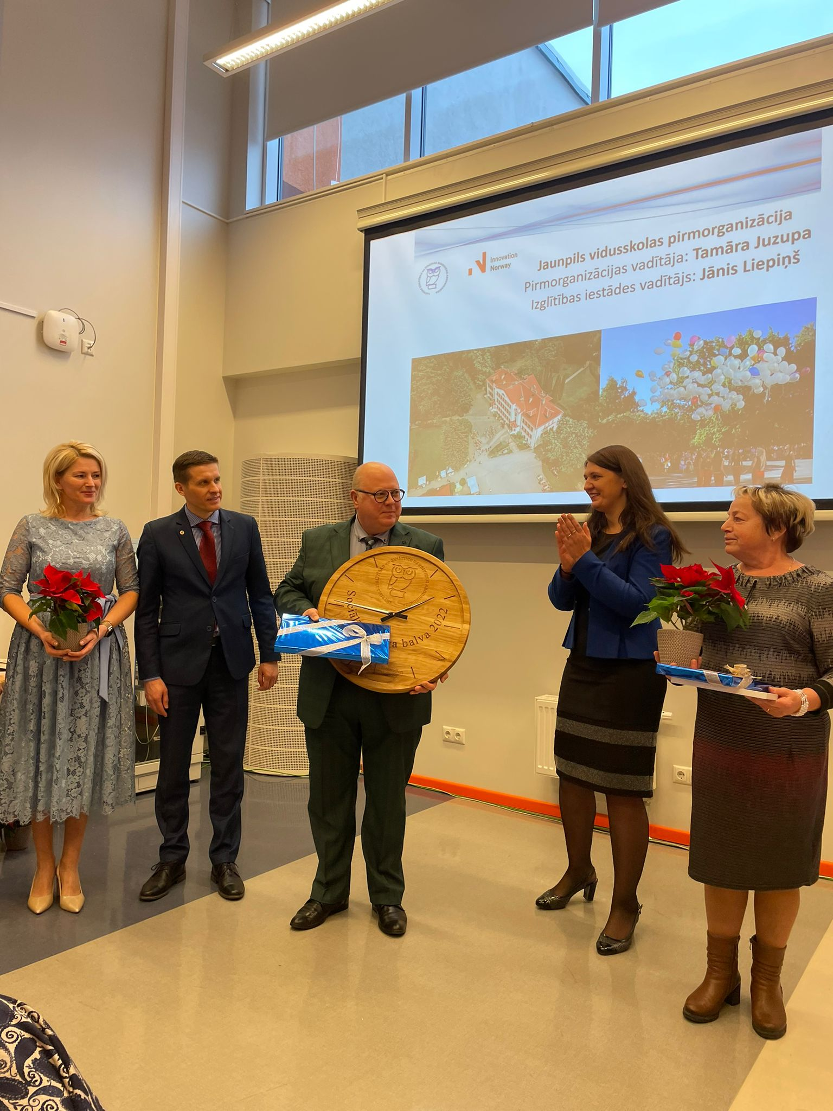
The 110th preschool educational institution in Riga
Head of the Primary organizations: Svetlana Kepša
Head of the educational institution: Valentina Hudjakova
The Jaunpils secondary school
Head of the Primary organizations: Tamara Juzupa
Head of the educational institution: Jānis Liepiņš

Slide 12
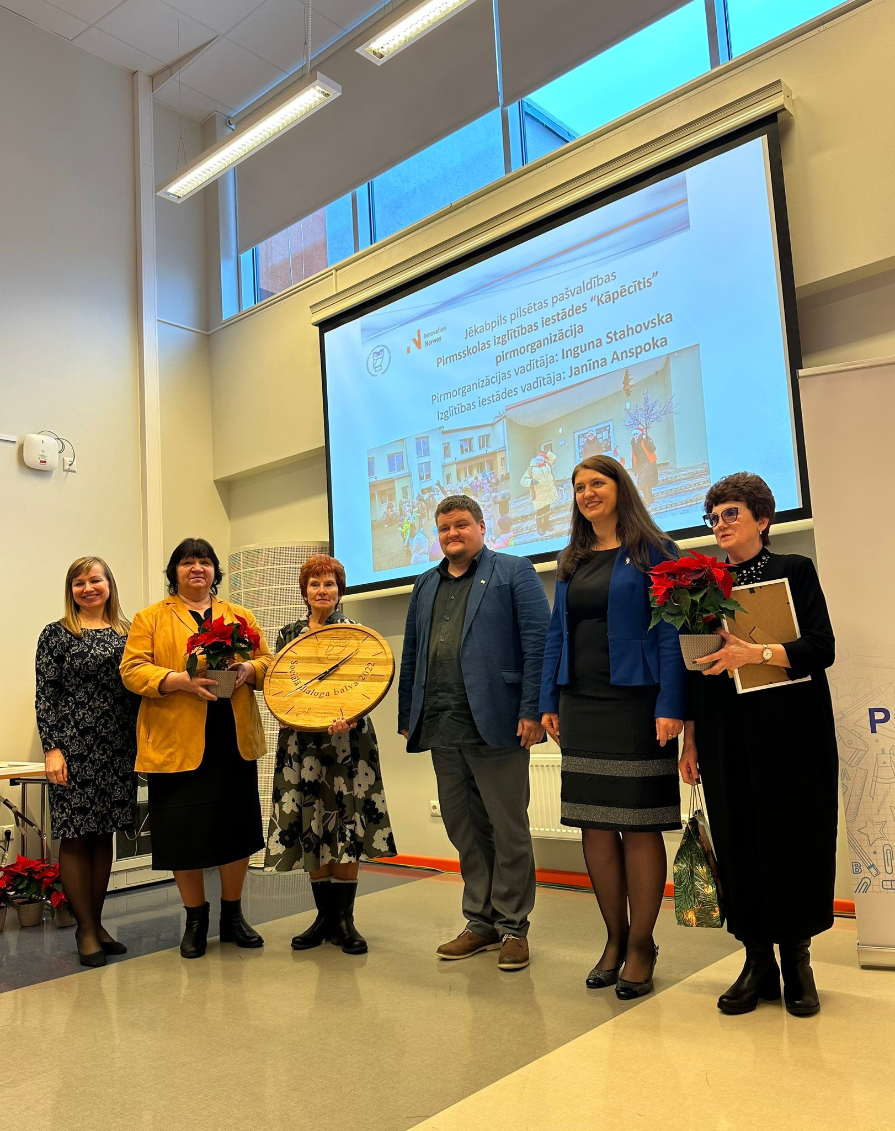
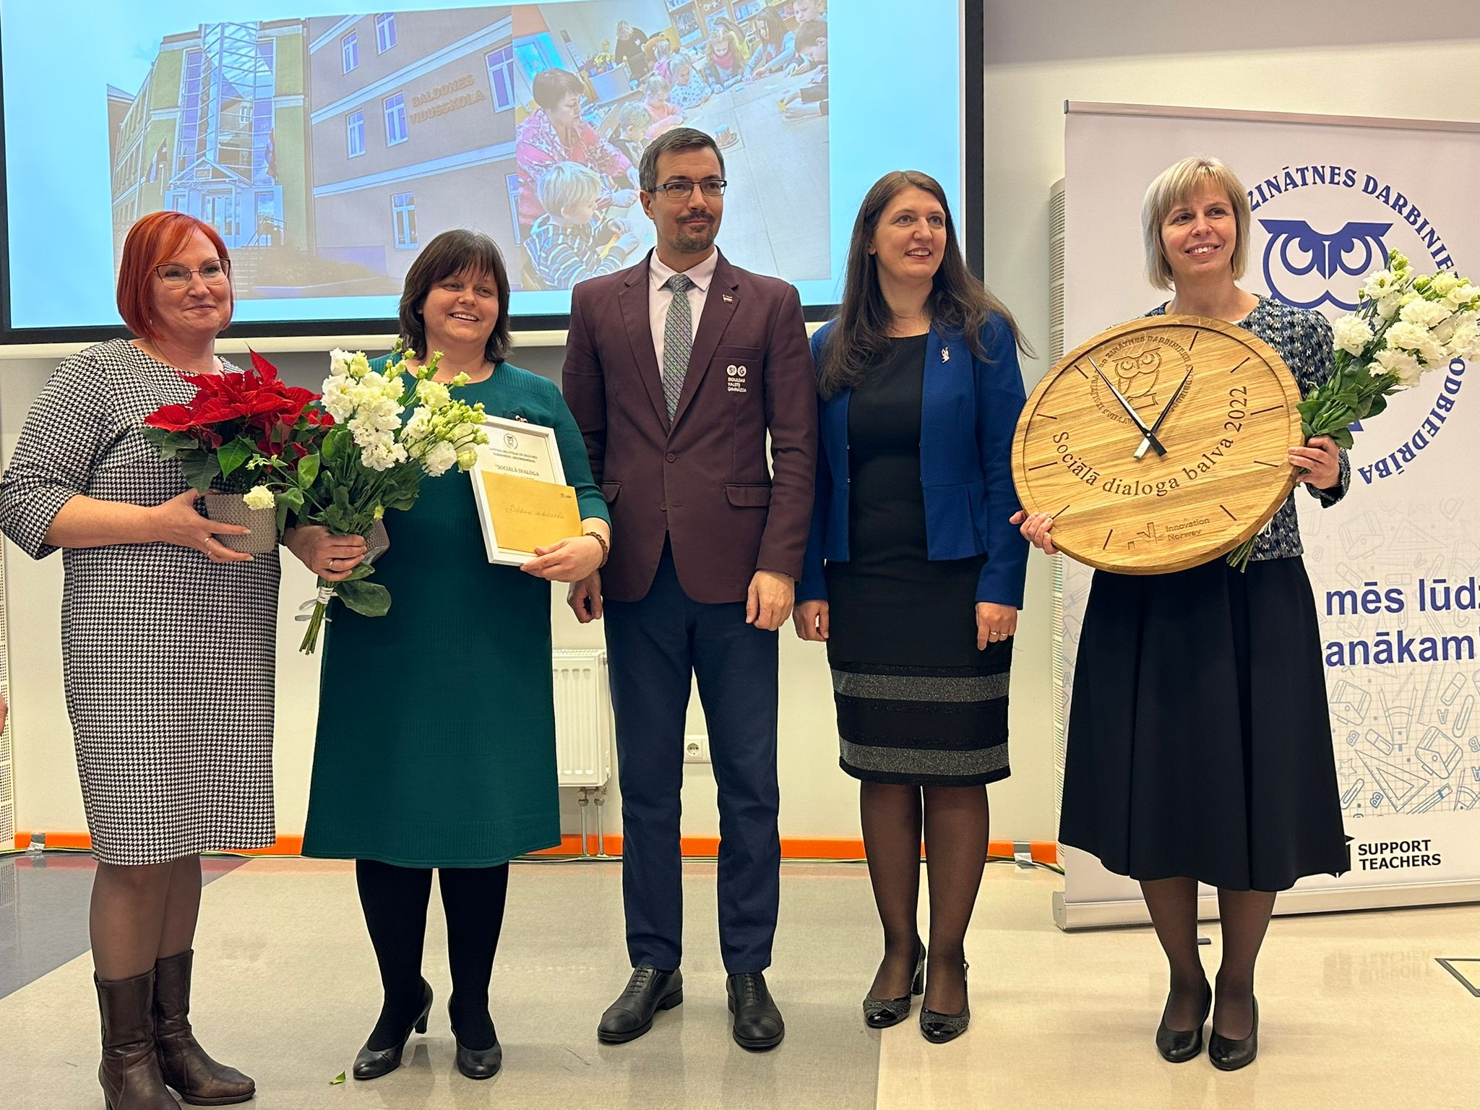
Baldones secondary school of Ķekava region
Head of the Primary organizations : Inese Čipāne – Kipāne
Head of the educational institution: Indra Šmite
Jēkabpils city municipalities
preschool educational institution "Kāpētis".
Head of the Primary organizations : Inguna Stahovska
Head of the educational institution: Janīna Anspok

Slide 13
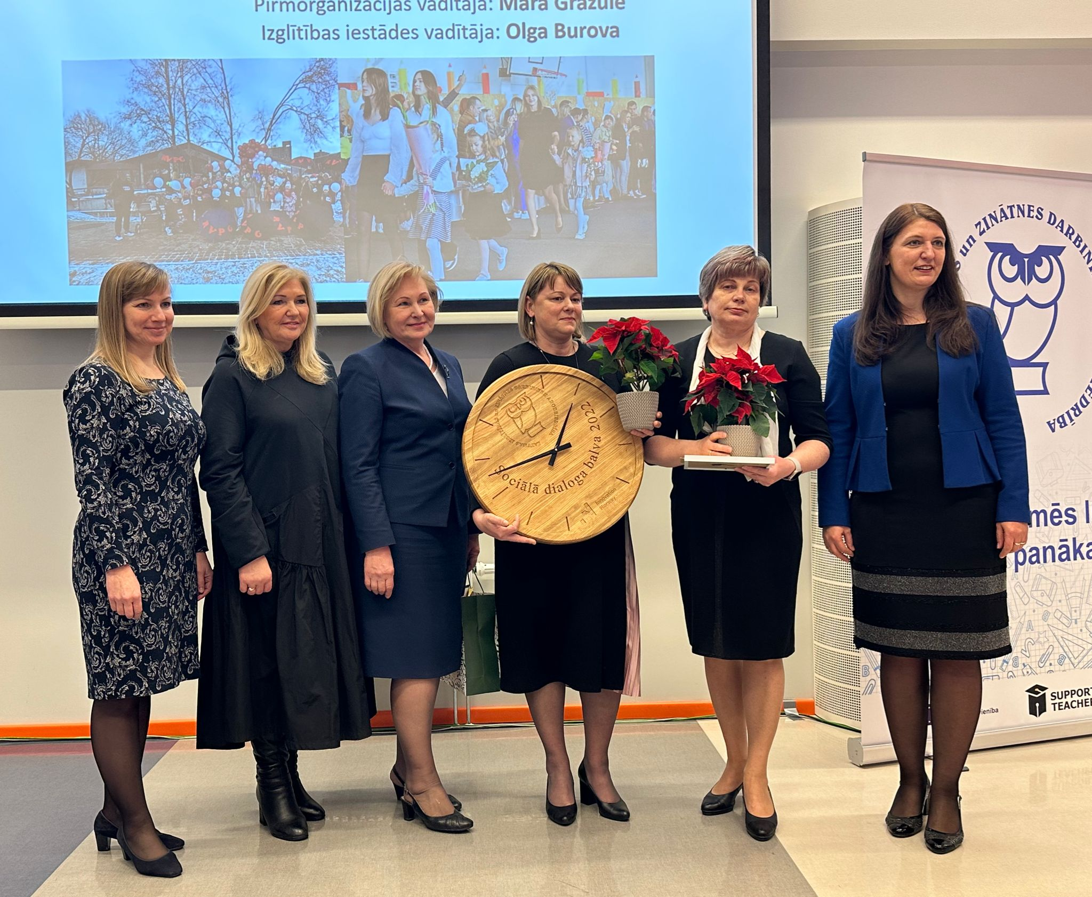
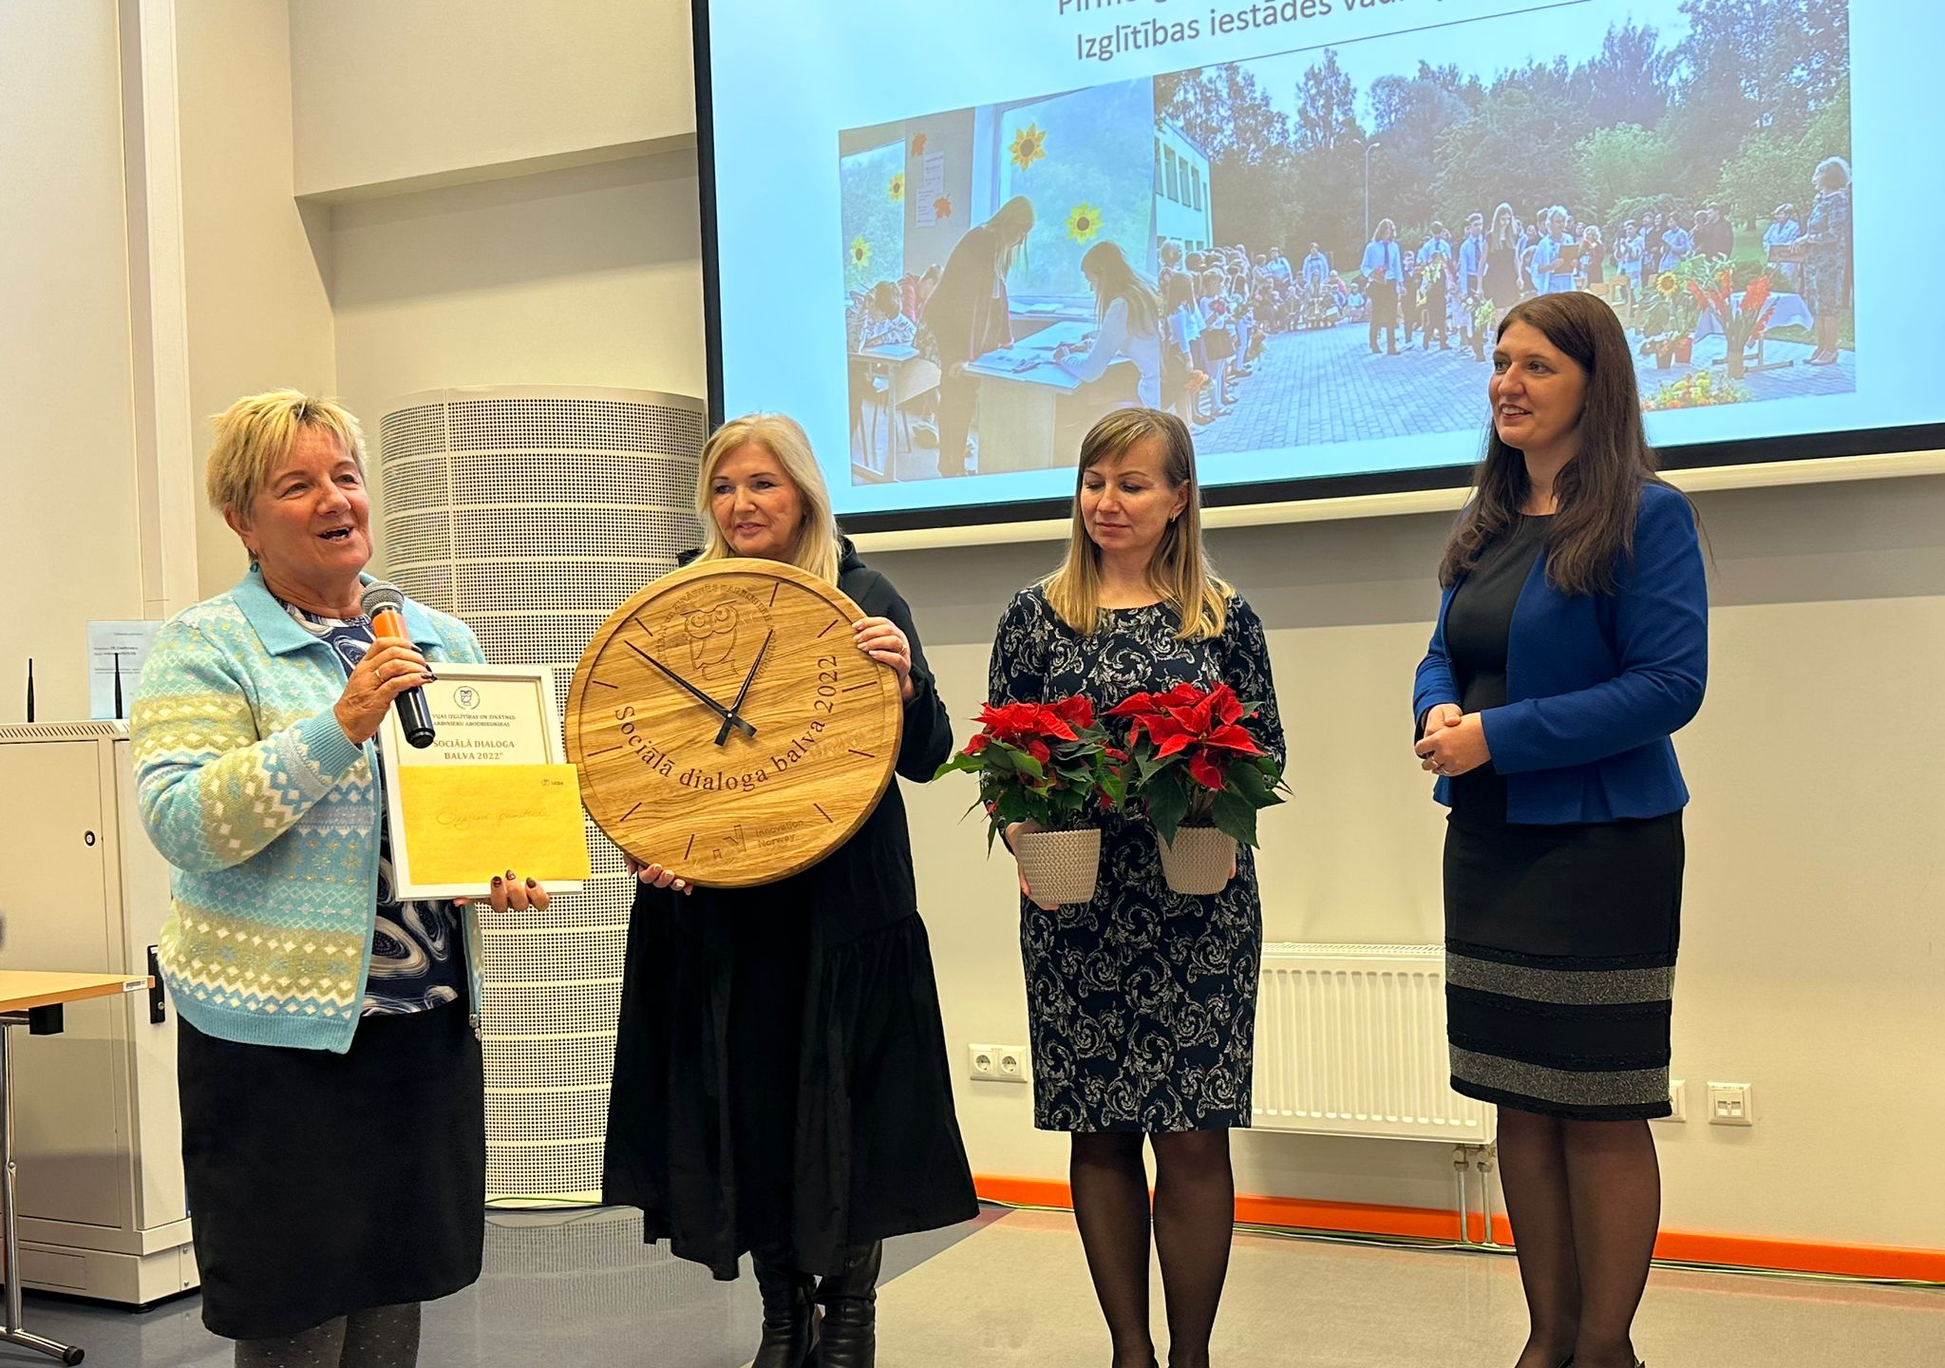
The Rēzekne State Polish Gymnasium
Head of the Primary organizations : Māra Gražule
Head of the educational institution: Olga Burova
The Skujene elementary school in Cēsu county
Head of the Primary organizations : Valda Miķelsone
Head of the educational institution: Anda Lukstiņa

Slide 14
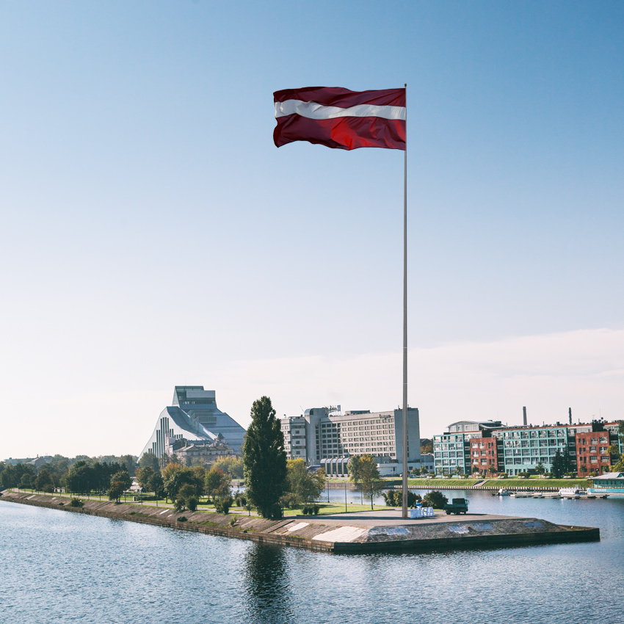
Thank you for your attention!

